Slide 1
TEACHER CUE
CFU
HINT
Scaffolding for students
MAKE THE CONNECTION
Allow students to make the connection

Slide 2
We are learning about energy
TRACK WITH ME
READ WITH ME
I can define what energy is and the units it is measured in
I can recognise there are two main types of energy
I can recognise that energy comes in a number of forms that belong to one of two types of energy

Slide 3
TEACHER CUE
Graffiti walk
Brainstorm
What is energy?
What does energy do?
What forms of energy exist?

Slide 4
Energy
Energy is the ability to do work on something.
There are two main types
Kinetic and potential energy.

Slide 5
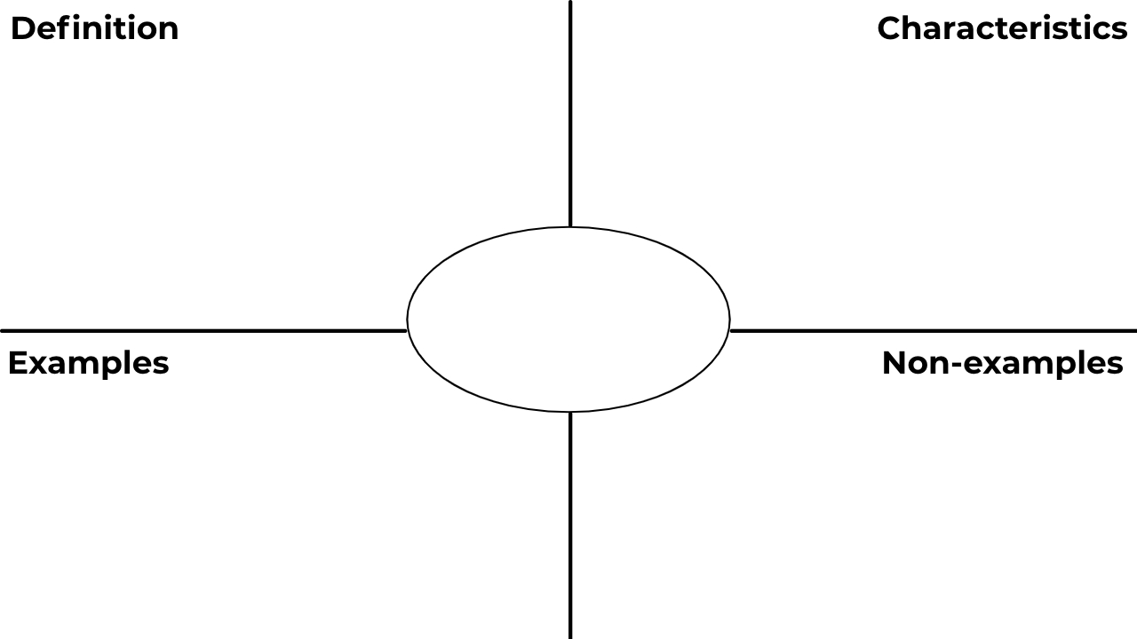
ENERGY

Slide 6
Energy makes things happen and allows work to be done
Has many different forms. Measured in joules (J)
ENERGY
Light
Heat
Anything that has matter
Mass
Time

Slide 7
WORK

Slide 8
Work occurs when energy is used to do something useful
When an object changes shape or an object changes its motion
WORK
Work is done on a can when it is crushed
Work is done on a football when it is kicked
Carrying two bags on each arm and they do not move
If you push on a wall it does not move

Slide 9
POTENTIAL ENERGY

Slide 10
This is stored energy that has the potential to make things happen.
Gravitational potential energy is due to height above the ground.
Elastic potential energy is due to a force applied to an object to try and deform it
POTENTIAL ENERGY
A rollercoaster high above the ground
A bungee cord stretched to its maximum
Blowing wind
A person climbing a ladder

Slide 11
KINETIC ENERGY

Slide 12
Energy due to the movement of an object
Can be transferred from one object to another
KINETIC ENERGY
Moving a soccer ball
Throwing a javelin
A pear hanging from a tree

Slide 13
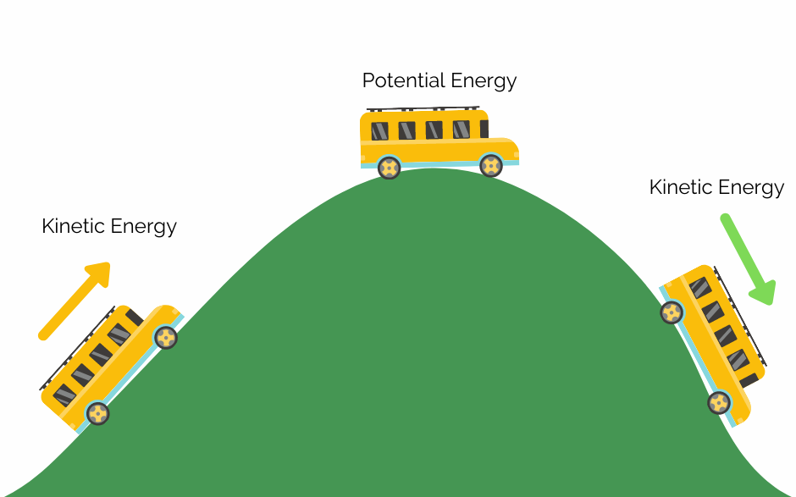
Potential energy vs kinetic

Slide 14
There are 5 forms of potential energy
Gravitational potential
Elastic potential
Chemical potential
Nuclear potential
Electric potential

Slide 15
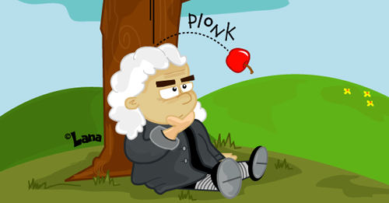
Vocabulary
Energy – The ability to do work Potential energy – stored energy that can be used in the future
Gravitational potential
Potential energy of an object elevated above the ground

Slide 16
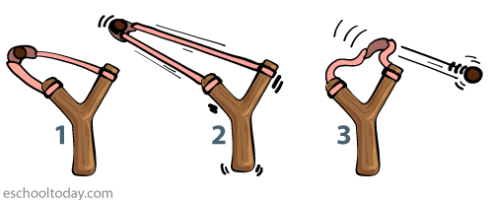
Vocabulary
Energy – The ability to do work Potential energy – stored energy that can be used in the future
Elastic potential
Energy stored by an elastic object that is stretched

Slide 17
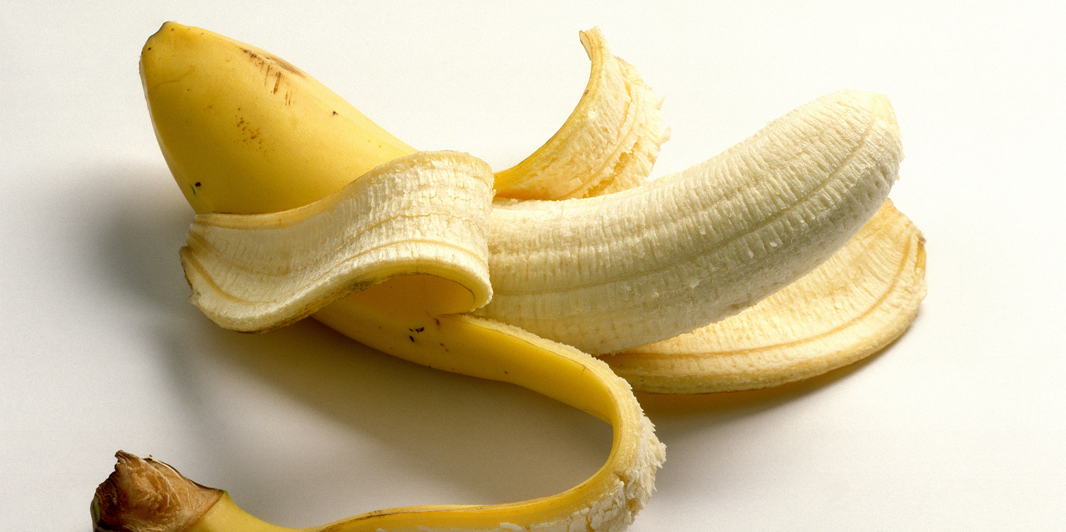
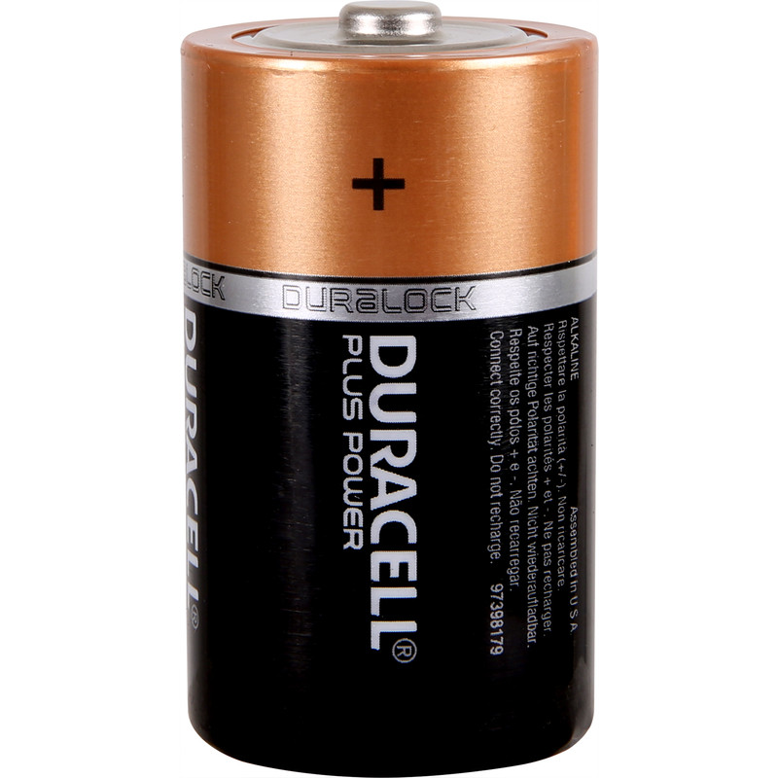
Vocabulary
Energy – The ability to do work Potential energy – stored energy that can be used in the future
Chemical potential
Energy stored in the form of chemicals that, when reacted together such as burning reactions, releases heat, sound or light

Slide 18
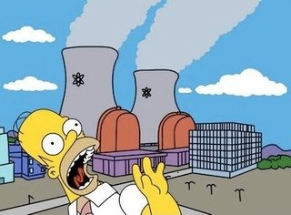
Vocabulary
Energy – The ability to do work Potential energy – stored energy that can be used in the future
Nuclear potential
Energy stored in the nucleus of atoms that can release energy slowly, such as in a nuclear reactor, or quickly, such as in a nuclear explosion

Slide 19
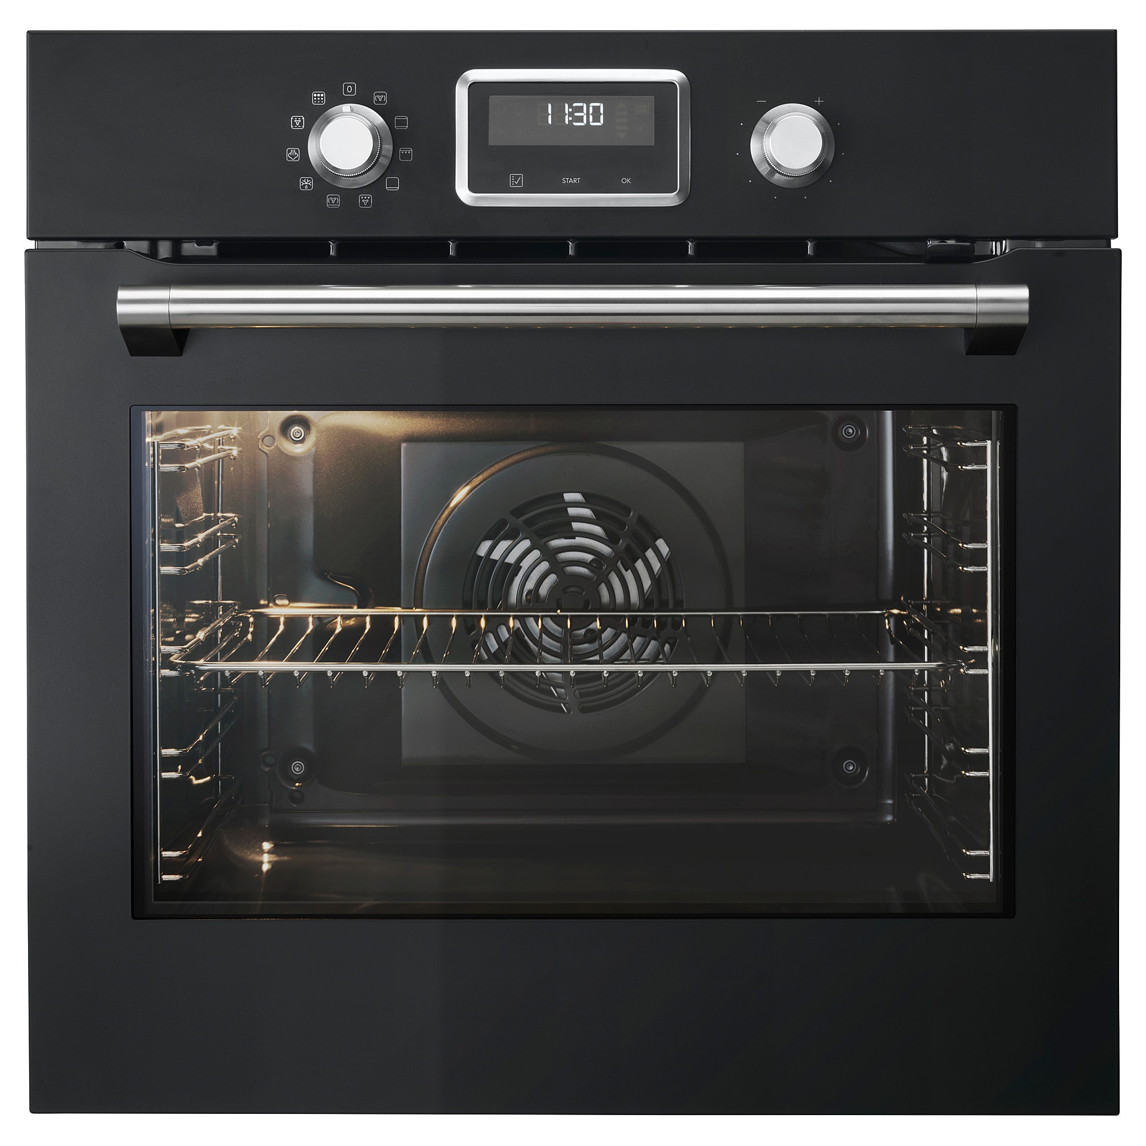
Vocabulary
Energy – The ability to do work Potential energy – stored energy that can be used in the future
Electric potential
Energy in moving charges or in static electric charges

Slide 20
Kinetic energy involves any energy of motion. This motion may be
Horizontal movement
Vertical movement
Vibration
Rotation

Slide 21
There are different forms of kinetic energy
Heat
Light
Sound

Slide 22
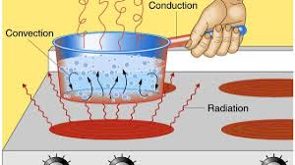
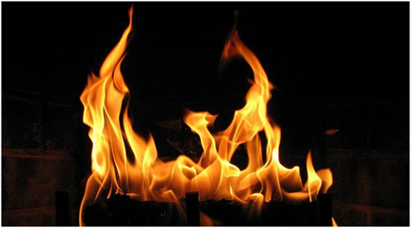
Vocabulary
Energy – The ability to do work Potential energy – stored energy that can be used in the future
Heat energy
Energy that causes objects to gain temperature
TEACHER CUE
CFU- How can we form heat energy?

Slide 23
Vocabulary
Energy – The ability to do work Potential energy – stored energy that can be used in the future
Light energy
Energy that may be released, for example, when an object is hot or by a nuclear reaction in a star
CFU 1
How can we form light energy?

Slide 24
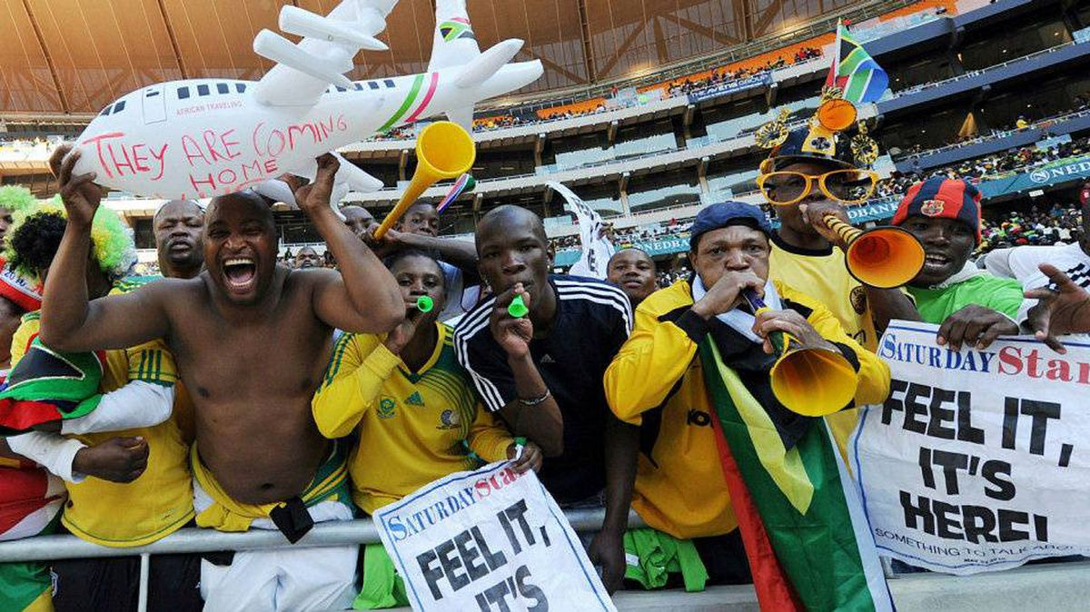
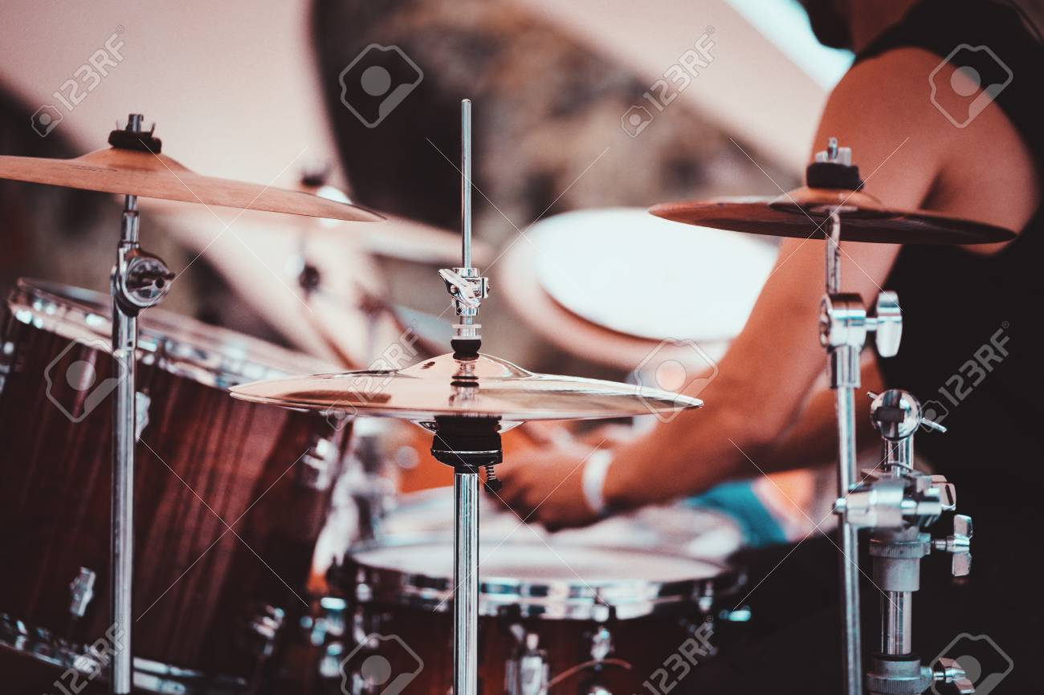
Vocabulary
Energy – The ability to do work Potential energy – stored energy that can be used in the future
Sound
Energy carried by the air in a room and detected by the ear

Slide 25
TEACHER CUE
CFU
Match each of these to the type of energy that it contains
A mug of coffee
Kinetic energy
A piece of coal
Elastic energy
A squashed spring
Chemical energy
A freewheeling bicycle
Heat energy

Slide 26
We are learning about types of energy
TRACK WITH ME
READ WITH ME
I can define what energy is and the units it is measured in
I can recognise there are two main types of energy
I can recognise that energy comes in a number of forms that belong to one of two types of energy

